Slide 1



UNIT 2
Lesson 8
IN &OUT OF FASHION
Part 1

Slide 2
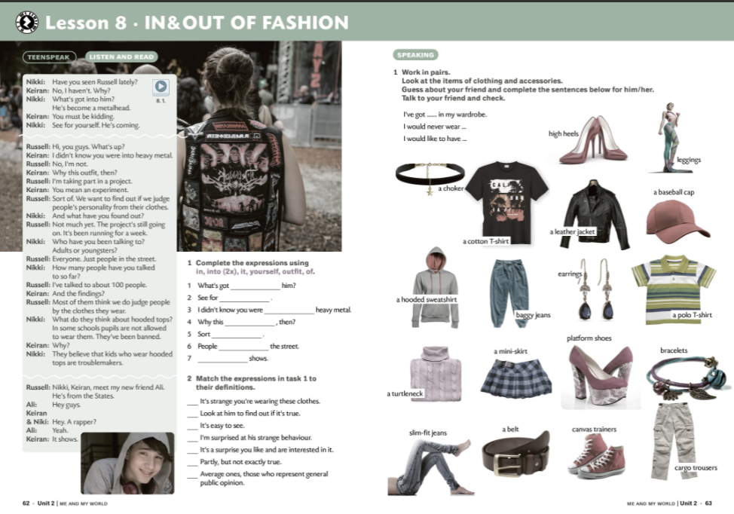
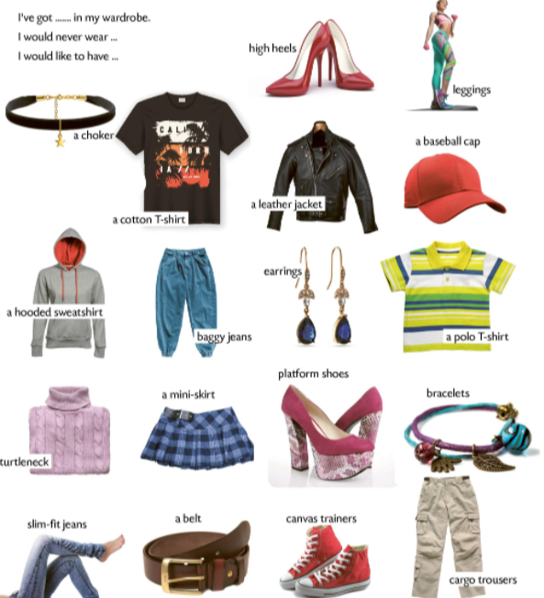
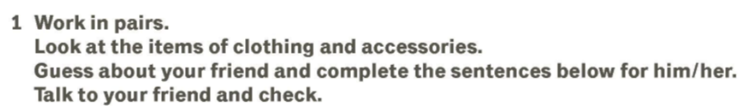
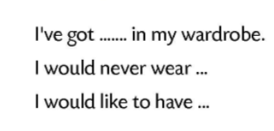
fashionable
BRAINSTORMING
trendy
designer
FASHION
industry
show
clothes
victim
accessories
models
catwalk
Add some more…

Slide 3

Dress code (a standard of what you should wear for a particular situation) means and that people, especially in the business world, know exactly what to wear and what not to wear on certain occasions.
The clothes metalheads (heavy metal fans) wear.
People in the street, both young people and adults.
About 100 people.
We do judge people by the clothes they wear. Because they think pupils who wear hooded tops cause trouble.
He’s been doing a project on clothes. The project has been running for a week.

Slide 4
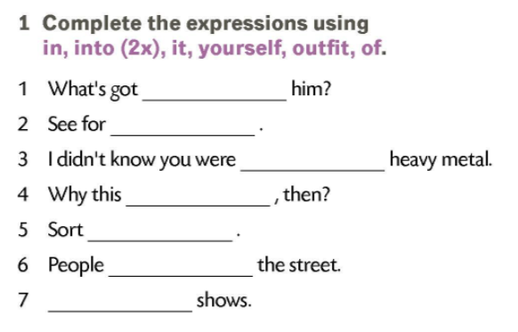
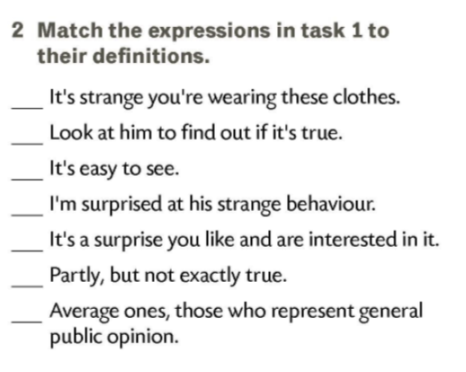
into
yourself
into
outfit
of
4
in
2
it
7
1
3
5
6

Slide 5
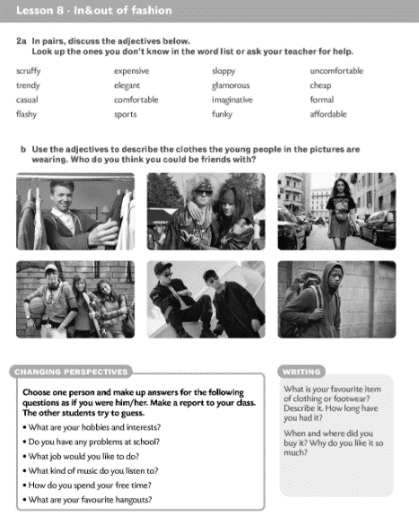
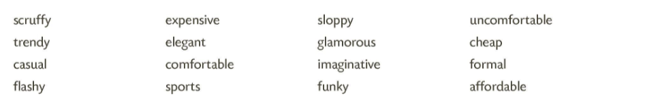
otrcano
skupocjeno
neuredno
neudobno
pomodno
profinjeno
raskošno
jeftino, nekvalitetno
ležerno
udobno
maštovito
svečano, službeno
kričavo, neukusno
sportski
otkvačeno
pristupačno

Slide 6
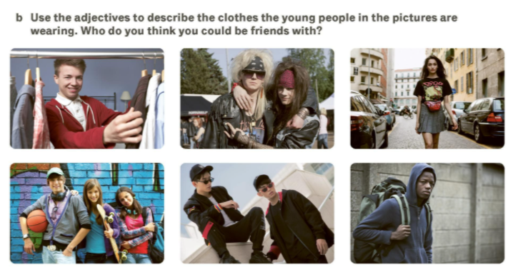
We often judge people by the clothes they wear.
What do you think?

Slide 7
